Slide 1
What Is It?
Eight Characteristics of Postmodernism

Slide 2
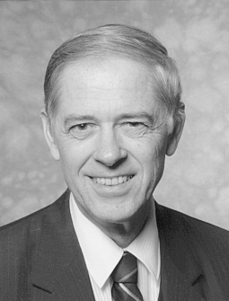
Major Emphases of Postmodernism
Premodern
Modern
Postmodern
Thomas C.Oden

Slide 3




Major Emphases of Postmodernism

Slide 4

Major Emphases of Postmodernism

Slide 5
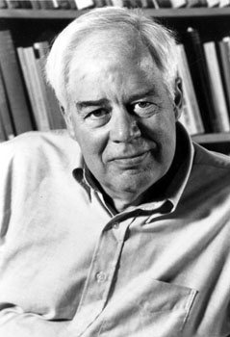

Major Emphases of Postmodernism
Truth is relative; there are no objective truths or absolutes.
  “Truth cannot be out there” (Rorty, 3).
  Saying something is true is merely “an empty compliment” (Rorty, 8).
  “Our purpose would be served best by ceasing to see truth as a deep matter, as a topic of philosophical interest” (Rorty, 8).

Slide 6
Major Emphases of Postmodernism
There is no essential human nature; humans are merely the contingent products of time and chance.
  “The very idea that the world or the self has an intrinsic nature—one which the physicist or the poet may have glimpsed—is a remnant of the idea that the world is a divine creation” (Rorty, 21).

Slide 7
Major Emphases of Postmodernism
There is no essential human nature; humans are merely the contingent products of time and chance.
  “There is no such thing as ‘human nature’ or the ‘deepest level of the self’” (Rorty, xiii).
  He views the discussion about “the nature of man” as “an unprofitable topic” (Rorty, 8).

Slide 8
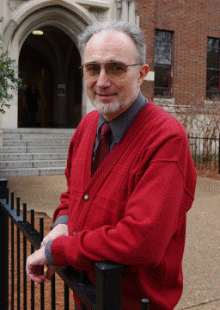

Major Emphases of Postmodernism
The author has no real authority; the reader gives a text its meaning.
  Patte asserts, “The text in and of itself does not ‘mean’ anything” (Patte, 94) until readers apply their interpretation to it.
  No interpretation is better than another’s; all interpretations are equally valid.

Slide 9
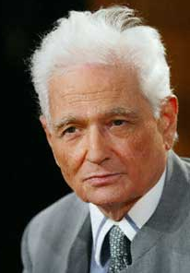

Major Emphases of Postmodernism
Language does not mean just one thing; it can mean whatever the reader wants it to mean.
  Jacques Derrida formulated a hermeneutical theory that argued that no single definitive interpretation of a text is possible.
  Words do not mean just one thing (monosemy) but are capable of a multiplicity of meanings (polysemy).

Slide 10
Major Emphases of Postmodernism
The mainstream of Western thought is ignored in favor of that which is on the margin of Western culture.
  Derrida cites Cezanne’s statement, “I do not ‘concentrate’ on those points that appear to be most ‘important,’ ‘central,’ ‘crucial.’ Rather I deconcentrate, and it is the secondary, eccentric, latter, marginal, parasitic, borderline cases which are ‘important’ to be” (Doty, 27).

Slide 11
Major Emphases of Postmodernism
Postmodernism is opposed to traditional Christianity, although in some cases it is open to other forms of spirituality.
  The postmodernist doctrine of historicism “has helped free us, gradually but steadily, from theology and metaphysics—from the temptation to look for an escape from time and chance” (Rorty, xiii).

Slide 12
Major Emphases of Postmodernism
Postmodernism is opposed to traditional Christianity, although in some cases it is open to other forms of spirituality.
  “The novel, the movie, and the TV program have, gradually but steadily, replaced the sermon and the treatise as the principal vehicles of moral change and progress” (Rorty, xvi).

Slide 13
Major Emphases of Postmodernism
Postmodernism is opposed to traditional Christianity, although in some cases it is open to other forms of spirituality.
    “we try to get to the point where we no longer worship anything, where we treat nothing as a quasi divinity, where we treat everything—our language, our conscience, our community—as a product of time and chance” (Rorty, 22).

Slide 14
Major Emphases of Postmodernism
Postmodernism is opposed to traditional Christianity, although in some cases it is open to other forms of spirituality.
    The liberal utopia “would be one in which no trace of divinity remained, either in the form of a divinitized world or a divinitized self” (Rorty, 45).

Slide 15
Major Emphases of Postmodernism
Postmodernism is opposed to traditional Christianity, although in some cases it is open to other forms of spirituality.
  “The process of de-divinitization . . . would ideally culminate in our no longer being able to see any use for the notion that finite, mortal, contingently existing human beings might derive the meanings of their lives from anything except other finite, mortal, contingently existing human beings” (Rorty, 45).

Slide 16
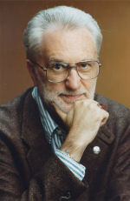

Major Emphases of Postmodernism
Postmodernism is opposed to traditional Christianity, although in some cases it is open to other forms of spirituality.
  William Doty takes pride that postmodernism “is evident today in the professional association of religious-studies teachers, the American Academy of Religion. . . . At least in professional academic religious studies, the sky’s the limit, and nothing remains taboo any longer” (Doty, 16).

Slide 17
Major Emphases of Postmodernism
Postmodernism is opposed to traditional Christianity, although in some cases it is open to other forms of spirituality.
  Doty thus agrees with Lynda Sexson that “we must fabricate, make up our sacred stories as we go along. . . . We do make/ create ourselves; . . . we are indeed goddesses and gods insofar as we repeatedly determine the Enframings toward which and through which everyday realities are experienced and reenvisioned” (Doty, 28).

Slide 18
Major Emphases of Postmodernism
Postmodernists discount the divine inspiration of Scripture, and emphasize modern reinterpretations over the original intent of the author.
  “For all we know, or should care, Aristotle’s metaphorical use of ousia, Saint Paul’s metaphorical use of agape, and Newton’s metaphorical use of gravitas, were the results of cosmic rays scrambling the fine structure of some crucial neurons in their respective brains” (Rorty, 17).

Slide 19
Major Emphases of Postmodernism
Postmodernists discount the divine inspiration of Scripture, emphasizing modern reinterpretations over the original intent of the author.
  “Traditional religious conservatives will surely reject such an approach, arguing from hierarchical perspectives such as medieval Christendom that only a single deity worshiped within a single parochial form of religiosity deserves worshipful attention” (Doty, 32).

Slide 20
Major Emphases of Postmodernism
Postmodernists discount the divine inspiration of Scripture, emphasizing modern reinterpretations over the original intent of the author.
      Patte likewise urges us to overcome “androcentric” and “Eurocentric” biases in interpreting Scripture (Patte, 25).

Slide 21

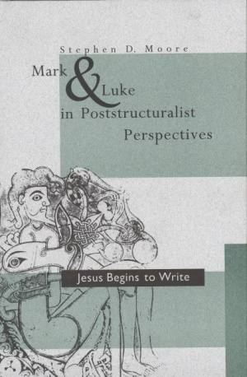
Major Emphases of Postmodernism
Postmodernists discount the divine inspiration of Scripture, emphasizing modern reinterpretations over the original intent of the author.
      Stephen D. Moore’s Luke in Poststructuralist Perspectives: Jesus Begins to Write includes the following chapters:

Slide 22
Major Emphases of Postmodernism
  Stephen D. Moore’s Luke in Poststructuralist Perspectives:
  Jesus Begins to Write includes the following chapters:
  “The Gospel of the Mark”
  “The Lion S(pr)ings”
  “Mark as Stripture”
  “The Objest of the Pun(ch) in Exegesis”
  “A(W)ri(o)ting with Plato’s Poets outside the City”
  “Mark’s Nightmaze: Writ(h)ing on a Bed of Paper”
  “Look-Ax: Luke’s Cutting Glance”

Slide 23
Major Emphases of Postmodernism
Postmodernists discount the divine inspiration of Scripture, and emphasize modern reinter- pretations over the original intent of the author.
  “. . . But the light is too bright for Peter to see or read by (Luke 9:33); he might as well be reading in the dark. A phosphorescent Jesus makes a poor reading lamp for the wor(l)d”

Slide 24
Major Emphases of Postmodernism
The postmodernist ethic emphasizes freedom and contingency, not objective morality and truth.
  Doty acknowledges that “one cannot preach ‘Just say no!’ if all values or contingent and transcendental ideals or deities are no longer thought to exist somewhere to give them birth” (Doty, 2).

Slide 25
Major Emphases of Postmodernism
The postmodernist ethic emphasizes freedom and contingency, not objective morality and truth.
  “Rorty asserts that “the distinction between morality and prudence, and the term ‘moral’ itself, are no longer very useful” (Rorty, 58).
  A Rorty-like postmodernist asks not, “What is right?” but “Why do you talk that way?” (Rorty, 51).

Slide 26
Pulpit Apologetics
Preaching to Postmoderns

Slide 27
Characteristics of
Contemporary Hearers
Rejection of authority
Doubt and skepticism about simplistic explanations
Relativism
Faith in feelings
Intolerant toleration
Notes:
We need to be careful of painting with too broad a brush. This is general and not to the same degree everywhere, but common enough to consider.
They feel betrayed by authorities. Why? Politicians, parents, corporations have all let them down. And they are mad. Sex & money scandals have added to this with religious authorities. Jim Jones & David Koresh have shown the dangers of blind obedience.
Internet has helped them question everything. So much is exposed as false. Science has failed to give answers. Religion has given shallow answers. Evolution has proven Bible wrong. Discovery & History Channels have helped.
Strong individualism. Multiculturalism.
What we feel is all that counts because that’s all we know. Subjectivism. We’ve been told to trust our hearts.

Slide 28
How Not to Be Apologetic
Stay in the Christian “bubble”
Speak only Christian-ese
Assume they know Bible stories
Know everything
Take yourself very seriously
Insult those who don’t believe or live like you do
Pick lots of battles
Don’t try to understand other belief systems
Notes:
We exist in bubbles. Don’t attend community functions or join community organizations. Only hang out with Christians and participate in Christian activities. ALSO, we can even have bubbles within the church—hanging with those in the church who are like-minded. Oh, and only listen to Christian music and watch the Hallmark Channel and Seventh Heaven reruns. You can’t risk exposing your mind to how the culture actually thinks and feels.
Use lots of terms like “saved,” “lost,” “born again,” “I’m a whosoever,” “I’m on the glory road,” and never explain what you mean.
Or at least speak like you do. Talk about how stuff in the Bible is so easy. Especially make remarks about how stupid people are (or wicked) who can’t see it so clearly. Contemporary listeners love authority figures who think they know everything.
Don’t ever laugh at yourself. If anyone ever says anything negative about you, deal with it in the pulpit. Constantly remind them that you are the pastor and that the Bible commands people to submit to your authority. After all, real authority is that which is forced and imposed. Postmoderns love strong and angry authority figures.
Refer to atheists as stupid. You can even quote Psalm 14:1 or 53:1. Speak very negatively about Sodomites and fornicators. Make sure to alienate everyone in whichever political party is godless. Oh, and always refer to people who trick-or-treat as devil worshipers.
Disney, Hollywood, and Subaru will always be the enemies, but that doesn’t mean you can’t find other people to boycott. After all, we must teach them a lesson. A good place to start is with businesses who say “Happy Holidays.”
Pagans don’t deserve your respect. You can get all the information about Islam, Judaism, Catholicism, Mormonism, Darwinism, and any other -ism by reading blogs and forwarded e-mails. The best way to win people to Christ is to preach against things they don’t actually believe.

Slide 29
Homiletical Elements in Communicating with Postmoderns
Use image-rich narratives/stories
Theological content
Take on rival systems
Proclaim mystery
Proclaim hope
Proclaim confidence
Proclaim truth
Proclaim Jesus Christ
Notes:
How do we speak to people that reject authority, are skeptical, hear with their eyes, and think with their hearts?
Learn to tell stories. Read Calvin Miller. Become friends with a story-teller. Don’t need all stories, but need to learn to tell them and tell them well.
Don’t be afraid to be theological. Give a theological vocabulary.
Theological and philosophical. Again, avoid strawmen.
People are suffering from information overload, but people are addicted to information. However, they are still enamored with transcendence. Where did I come from? What am I here for? How do I know that God exists? Where will I go when I die? Give them the wonder and beauty of God without trying to make everything analytical and compact.
Disillusioned by modernity. Created in image & likeness of God. Incarnation & resurrection of Christ. Hope of eternity.
The Christian faith provides the answers to life’s problems. Tell them why they can place their faith in something that is real.
Be confident about absolute truth claims, and explain why.
Who He is. What He has done.
We will need to use these to the extent that our context demands.

Slide 30
Sermon Delivery for Postmoderns
Be open to “Edutainment”
Use PowerPoint and videos for a generation raised on videos
Reference contemporary culture
(recent movies, TV, etc.)
Show genuine humility
Be real and transparent
Speak with prophetic authority
Stand for something, but don’t rail
Notes:
This is actually important in apologetics. Many church contexts might be ok with certain of these elements missing, but not in a postmodern setting, and not to skeptics.
Be funny, but don’t have to tell jokes.
They know if you’re faking it. Preachers have egos & insecurities. Work on it. Admit when you are wrong. Laugh at yourself. Don’t take yourself too seriously.
You speak as God’s spokesman. Don’t apologize.
Brutal honesty is one thing, but brutality is another. 2 Timothy 2:22-26. Respect. Kindness. Gentleness.

Slide 31
Pulpit Apologetics
Preaching to Postmoderns

